Slide 1
Virtualization in Cloud Computing
Seminar Guide: S. S. Kolte
Name: Jaysheel Dodia
Roll: 20CO045
Class: TE Computer A

Slide 2
What is Virtualization?
Virtualization is the ability to run multiple operating systems on a single physical system and share the underlying hardware resources.
Virtualization uses software that simulates hardware functionality to create a virtual system. This practice allows IT organizations to operate multiple operating systems, more than one virtual system and various applications on a single server.
Virtualization is used to improve IT throughput and costs by using physical resources as a pool from which virtual resources can be allocated.

Slide 3
What is Cloud Computing?
Cloud Computing is the delivery of computing services—including servers, storage, databases, networking, software, analytics, and intelligence—over the Internet (“the cloud”) to offer faster innovation, flexible resources, and economies of scale
These computing services are provided by Cloud Service Providers such as Amazon Web Services, Microsoft Azure, Google Cloud, etc.
Most of the physical hard work such as setting up and maintenance of hardware, managing network and setting up these resources is done by the cloud service provider. These helps the user only focus on the actual application or the solution, that he/she needs to implement.

Slide 4
Virtualization Architecture
A Virtual machine is an isolated runtime environment
Multiple virtual systems (VMs) can run on a single physical system

Slide 5
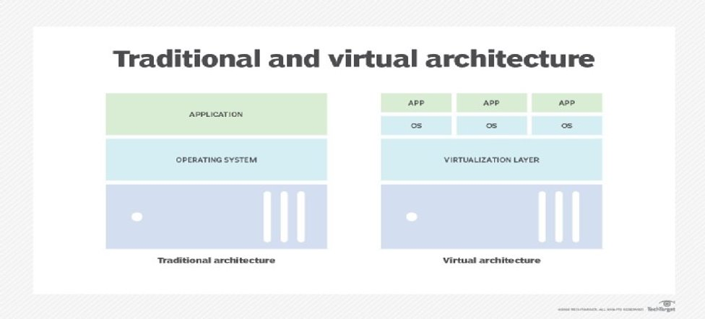

Slide 6
Benefits of Virtualization
Cost Reduction: Sharing of available resources, eliminate the need to provision/purchasing new resources.
Isolation: Virtual machines are isolated from each other as if they are physically separated.
Encapsulation: Virtual machines encapsulate a complete computing environment.
Hardware Independence: Virtual machines run independently of underlying hardware.
Portability: Virtual machines can be migrated between different hosts.

Slide 7
Virtualization in Cloud Computing
In Cloud Computing, virtualization facilitates the creation of virtual machines and ensures the smooth functioning of multiple operating systems. It also helps create a virtual ecosystem for server operating systems and multiple storage devices, and it runs multiple operating systems.
Virtualization and Cloud Computing work hand in hand to ensure that you will get advanced and sophisticated levels of computing. It ensures that applications can be shared across multiple network threads of different enterprise and active users.
Cloud Computing delivers scalability, efficiency, and economic value. It offers streamlined workload management systems.

Slide 8
How are the VMs maintained?
A Hypervisor, a.k.a. a virtual machine manager (VMM), or virtualization manager, is a program that allows multiple operating systems to share a single hardware host.
A well-known example of a hosted hypervisor is Oracle VM VirtualBox. Others include VMware Server and Workstation, Microsoft Virtual PC, KVM, etc.
Each guest operating system appears to have the host's processor, memory, and other resources all to itself. However, the hypervisor is actually controlling the host processor and resources, allocating what is needed to each operating system in turn and making sure that the guest operating systems (called virtual machines) cannot disrupt each other.

Slide 9
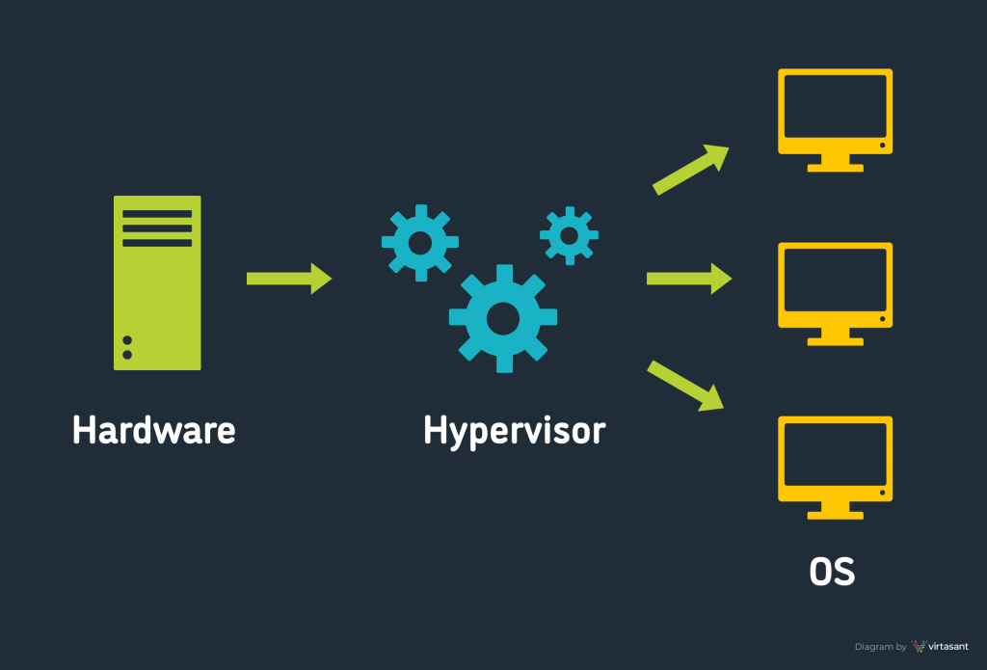

Slide 10
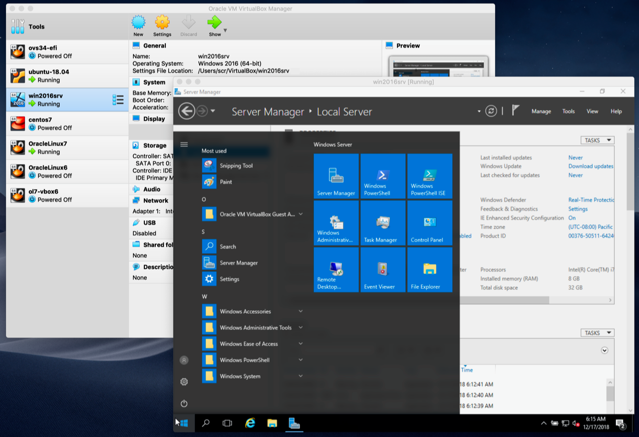

Slide 11
Virtualization in Cloud Computing
Cloud computing takes virtualization one step further:
You don’t need to own the hardware or network resources
Resources are rented as needed from a cloud service provider
Various providers allow creating virtual servers:
Choose the OS and software each instance will have
The chosen OS will run on a large server farm
Can instantiate more virtual servers or shut down existing ones within minutes
You get billed only for what you have used.

Slide 12
Virtualization Security Requirements
Scenario: A client uses the service of a cloud computing company to build a remote VM
A secure network interface
A secure secondary storage
A secure run-time environment
Build, save, restore, destroy

Slide 13
Roles of the Hypervisor
Isolating/Emulating resources
CPU: Allocating CPU cores
Memory: Managing memory
I/O: Emulating I/O devices
Networking
Managing virtual machines
Emulating I/O devices

Slide 14
References
VMWare official website : https://www.vmware.com/in/solutions/virtualization.html
Microsoft Learn: https://learn.microsoft.com/en-us/training/modules/describe-benefits-use-cloud-services/
S. Gopala Krishnan: Virtualization and Cloud Technologies article in IJARCCE

